Slide 1

Virginia’s
Registered Apprenticeship

Slide 2
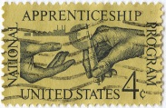
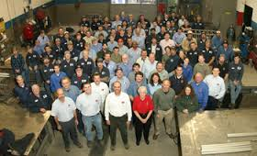
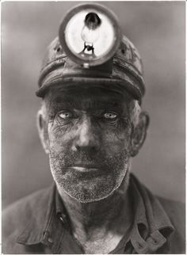
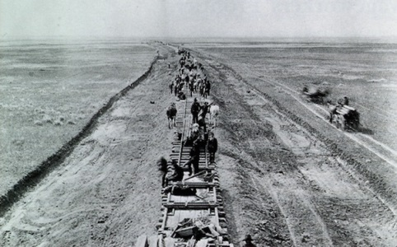
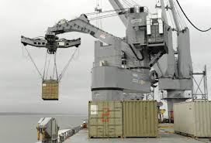
Registered Apprenticeship
Registered Apprenticeship was established in Virginia with the signing of the Virginia Apprenticeship Act in 1938
Voluntary Program

Slide 3
Registered Apprenticeship
Today, over 70% of currently identified occupations require credentials beyond high school; 20% still require a 4 year degree
Registered Apprenticeship helps to ensure that Virginia has a highly skilled and credentialed workforce

Slide 4
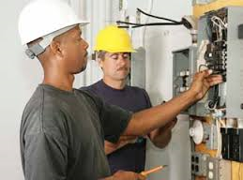
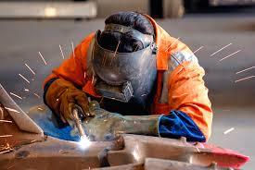
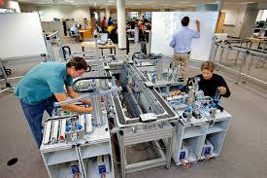
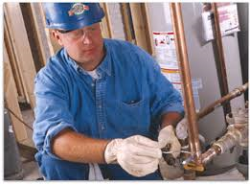
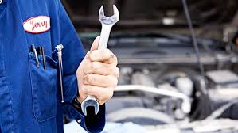
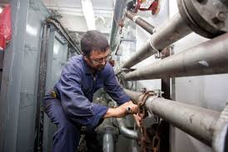
Registered Apprenticeship
Over 350 occupations are actively registered in Virginia with over 1,000 occupations approved for registration by the USDOL, Office of Apprenticeship
A variety of occupations include welders, electricians, opticians, plumbers, machinists, ship fitters, maintenance mechanics, multi craft technicians, mechatronics technicians, IT, and Cyber security

Slide 5
Registered Apprenticeship
Modern Registered Apprenticeship combines carefully defined and employer-specific training under the guidance of a highly skilled mentor at the work site
On-the-job training is supplemented with related technical instruction
Ideal workforce partnership

Slide 6
REGISTERED
APPRENTICESHIP
HOW IT WORKS

Slide 7
How It Works
On-the-Job-Training
  Registered employers (sponsors) provide on-the-job training to employees (apprentices)
  A minimum of 2,000 on-the-job training hours are required
  Most skilled occupations take 3-4 years to achieve proficiency
  Each apprentice works closely with a highly skilled mentor/journey worker for maximum results

Slide 8
How It Works
Related Occupation Instruction
  Apprentices attend classes at their local community college, vocational technical center, on-line, or the sponsor’s site. Student apprentices can begin occupational education and on-the-job learning in high school
  All Instruction is occupation specific
  Participants spend approximately six hours a week for a minimum of 144 annual contact related instructional hours

Slide 9
How It Works
Employee Requirements
  Most employers require a high school diploma or a GED and high levels of math and communication skill-these requirements are determined by employers
  Instruction is occupation specific
  Must be at least 16 years old
  Full-time schedules are the norm; however a part-time opportunity may exist in certain circumstances and certain industries.
  Ability to master techniques and technology of the occupation.

Slide 10
Advantages
  Ensure your company maintains highly skilled workforce
  Enable new employees to quickly contribute to company productivity
  Instill loyalty and decrease turnover
  Acquire employees with safe and healthy work habits and practices

Slide 11
Advantages
  Combat the challenges of advancing technology, shifting consumer demands, evolving business practices
  Meet the needs for closing the middle skills gap and the issues surrounding the mass exit of aging workforce.
  Nationally recognized journeyworker status

Slide 12
Customers Served
More than 2,000* sponsors
More than 15,500* apprentices
In 2016, approximately 4,000* apprentices will receive Certificates of Completion
* Based on current FY 2016-2017

Slide 13
REGISTERED
APPRENTICESHIP
HOW TO GET
STARTED

Slide 14
How To Get Started
Meet with a DOLI local apprenticeship consultant to develop a registered program
Review classroom instruction program with your local apprenticeship consultant
Select employee(s) to provide on-the-job training and serve as mentors
Identify employee(s) who are willing to become registered apprentice(s)

Slide 15
Our Staff Provides
Assistance to sponsors in developing specific work processes for occupations to fit individual employer needs
Referral information for sponsors to Workforce Development Partners and possible grant opportunities
Follow up with employers periodically
Certificates of Completion and journeyworker cards upon successful completion

Slide 16
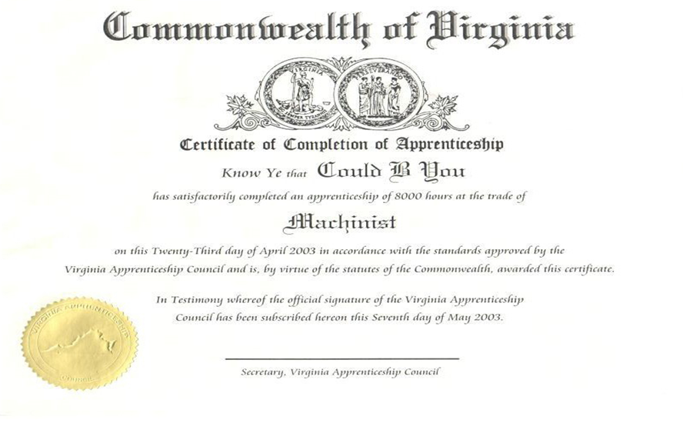

Slide 17

Apprenticeship Programs
In Virginia
80+ YEARS OF DELIVERABLES AND RESULTS

Slide 18
REGISTERED
APPRENTICESHIP
OUTCOMES
AND
BENEFITS

Slide 19
Apprenticeship Programs
In Virginia
Improve morale and self-esteem
Provide incremental wage increases
Encourage regular evaluation of job performance and related instruction
Improve opportunity for advancement

Slide 20
REGISTERED
APPRENTICESHIP
Offers practical, dignified, life-long, rewarding and financially successful careers in wide variety of skilled occupations that are and will remain in demand for many years

Slide 21
Virginia’s Top 20 Registered Apprenticeship Occupations
ELECTRICIAN
PIPE FITTER CONSTRUCTION
MAINTENANCE MECHANIC
COSMETOLOGIST
HVAC-ENVIRONMENTAL-CTRL
PLUMBER
ELECTRONICS TECHNICIAN
ELECTRONICS MECHANIC
MACHINIST
COOK, ANY INDUSTRY
AVIATION ORDNANCEMAN
OPTICIAN, DISPENSING II
PIPE FITTER SHIP
ELECTRICIAN, MAINTENANCE
ELECTRICIAN, SHIP & BOAT
SHEET-METAL WORKER
BARBER
WELDER, COMBINATION
OFFICE CLERKS, GENERAL
LINE ERECTOR

